Slide 1

Office 365 for Education
Introduction

Slide 2

Agenda
Why Office 365?
CCCD Implementation
Google Apps and Office 365
Office Features and Programs
Q & A
Office365

Slide 3

What is Office 365?
Notes:
Free copy of Office 2016
Latest version of MS Office
Microsoft transitioning Office to subscription model, no more shrinked wrapped software
Adobe Creative Cloud is Adobe’s attempt
An app for your phone

Slide 4
From: Blackmore, Chris
Sent: Monday, February 08, 2016 10:30 AM
To: DL CCC All Employees <DL_CCC_All_Employees@cccd.edu>
Cc: Oberlin, Craig <coberlin1@cccd.edu>; Saran, Rupa <rsaran1@cccd.edu>; Harrison, Kevin <kharrison@gwc.cccd.edu>
Subject: Office 365 for Faculty and Staff
Office 365 for Faculty and Staff
As an employee of the Coast Community College District, you are entitled to a free subscription to Microsoft Office 365 for Educators. While the District provides Office (Word, Excel, PowerPoint, and Outlook) for use on District-owned equipment, with Microsoft Office 365 for Educators you may install Office 2016 to your personally owned computer (MAC and Windows) and mobile device (iOS and Android) while also having 1 TB of OneDrive cloud-based storage. You can install on as many as 5 devices.
At this time, we are asking that you do not install Office 2016 to District-owned computers. There is an Enterprise version of Office 2016 that IT will be rolling out this summer. However for Faculty using District-owned laptops, should you need Office 2016 for curriculum development, you may install Office 2016 on this device.
To sign up for your free Office 365 for Educators account go to http://office.com/getoffice365. You will be prompted to enter your District-issued email address (e.g. jdoe1@cccd.edu). You can’t use your @coastline.edu email address, only your @cccd.edu email address. An email will be sent to that address with instructions on how to complete the steps for your account.

Slide 5
CCCD Office 365 Implementation
Today:
  Office 365 is a stand alone system, different userID and password
  Students, faculty, and staff are in different tenants (environment)
Future:
  Office 365 will be single sign on (SSO)
  Same userID and password as computer logon and OWA
  Students, faculty, and staff will be in a single tenant

Slide 6


Office 365 vs. Google Apps
Common
Cloud storage
Document collaboration
Email
Online productivity apps
Google Apps
Apps
Device management
All cloud based
Office 365
Integrates with desktop Office products
Works in a hybrid environment
Familiar user interface
Information security
Notes:
Mention digital signage
GAPPS clunky user interface
CCCD Google Apps – Limited implementation, 4 Apps, student email, only accessible through MyCCC
Coastline – Stand alone system for Special Programs at NBC, Open

Slide 7





Educators
Own the classroom experience – Look to be unique and innovative
Institutions
Integrating technology seamlessly with teaching practices delivering impact to learning outcomes

Slide 8

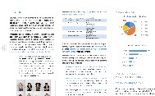


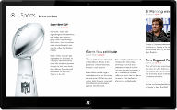


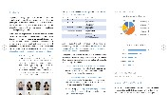


Hybrid
On Premises
Online
Best experience across devices
Cloud on your terms
Voice
& Video
Content Management
Enterprise Social
Reporting
& Analytics
Messaging
Integrated best-of-breed solutions

Slide 9







Office 365 Feature Overview
Empower your schools with an enterprise class productivity suite and communications infrastructure

Slide 10













Office 365 Product Overview

Slide 11








Full Lync feature set
Design inspired by Skype
Skype for Business
Server, hybrid, and cloud
Enterprise grade

Slide 12

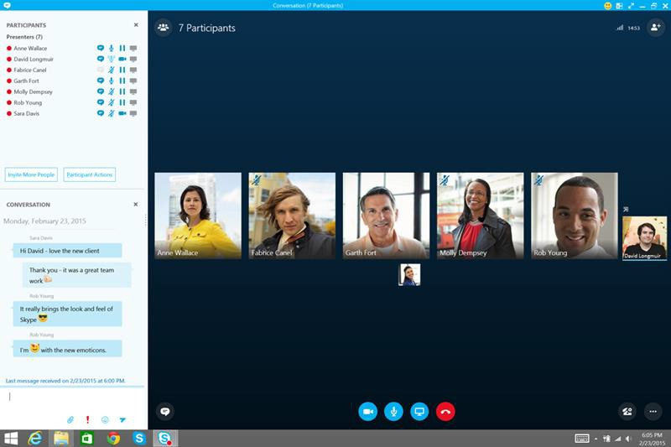

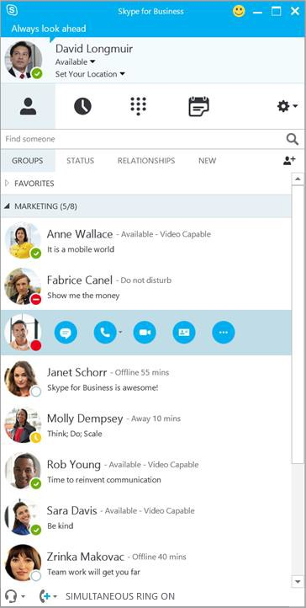
Skype for Business
Participant HD video gallery
Different than Skype Consumer
Multiparty HD video & content sharing
Modern, mobile and web clients
Integration across Office apps
Presenter Controls
Skype-like Interface

Slide 13






Discover
Share

Slide 14
Create sites in a few simple clicks
Office365

Slide 15
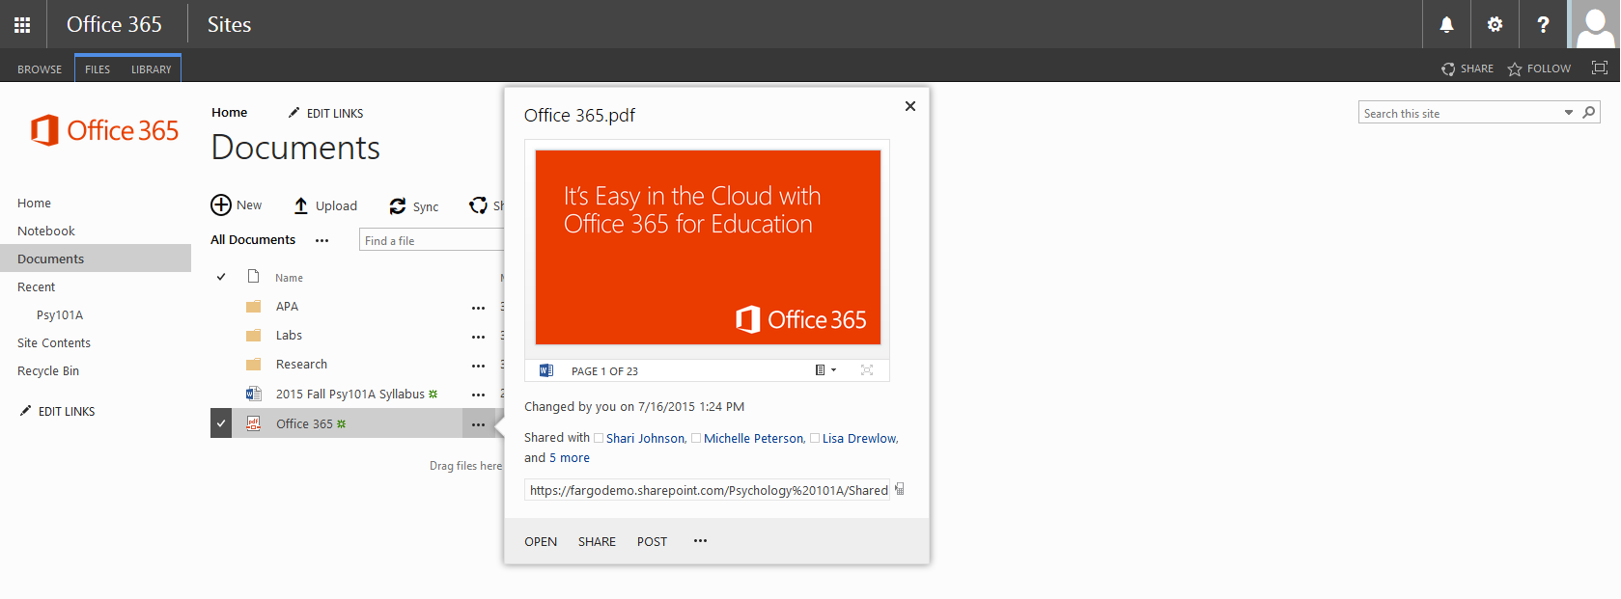
Streamline common tasks
Office365

Slide 16
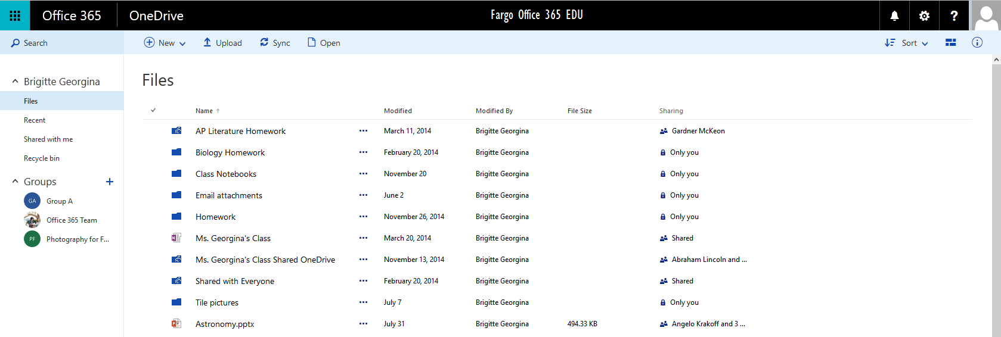
OneDrive for Business
1 TB OneDrive Individual Storage
Office365
Notes:
Store, share, and sync documents.
Cloud based storage
Syncs across all devices

Slide 17
Office Online
Word, Excel, PowerPoint, and OneNote via web browser
Great for content creation on the go
Save automatically to OneDrive for Business
Can be opened in Office on the desktop
Browser to browser co-authoring
Real-time co-editing
Office365

Slide 18
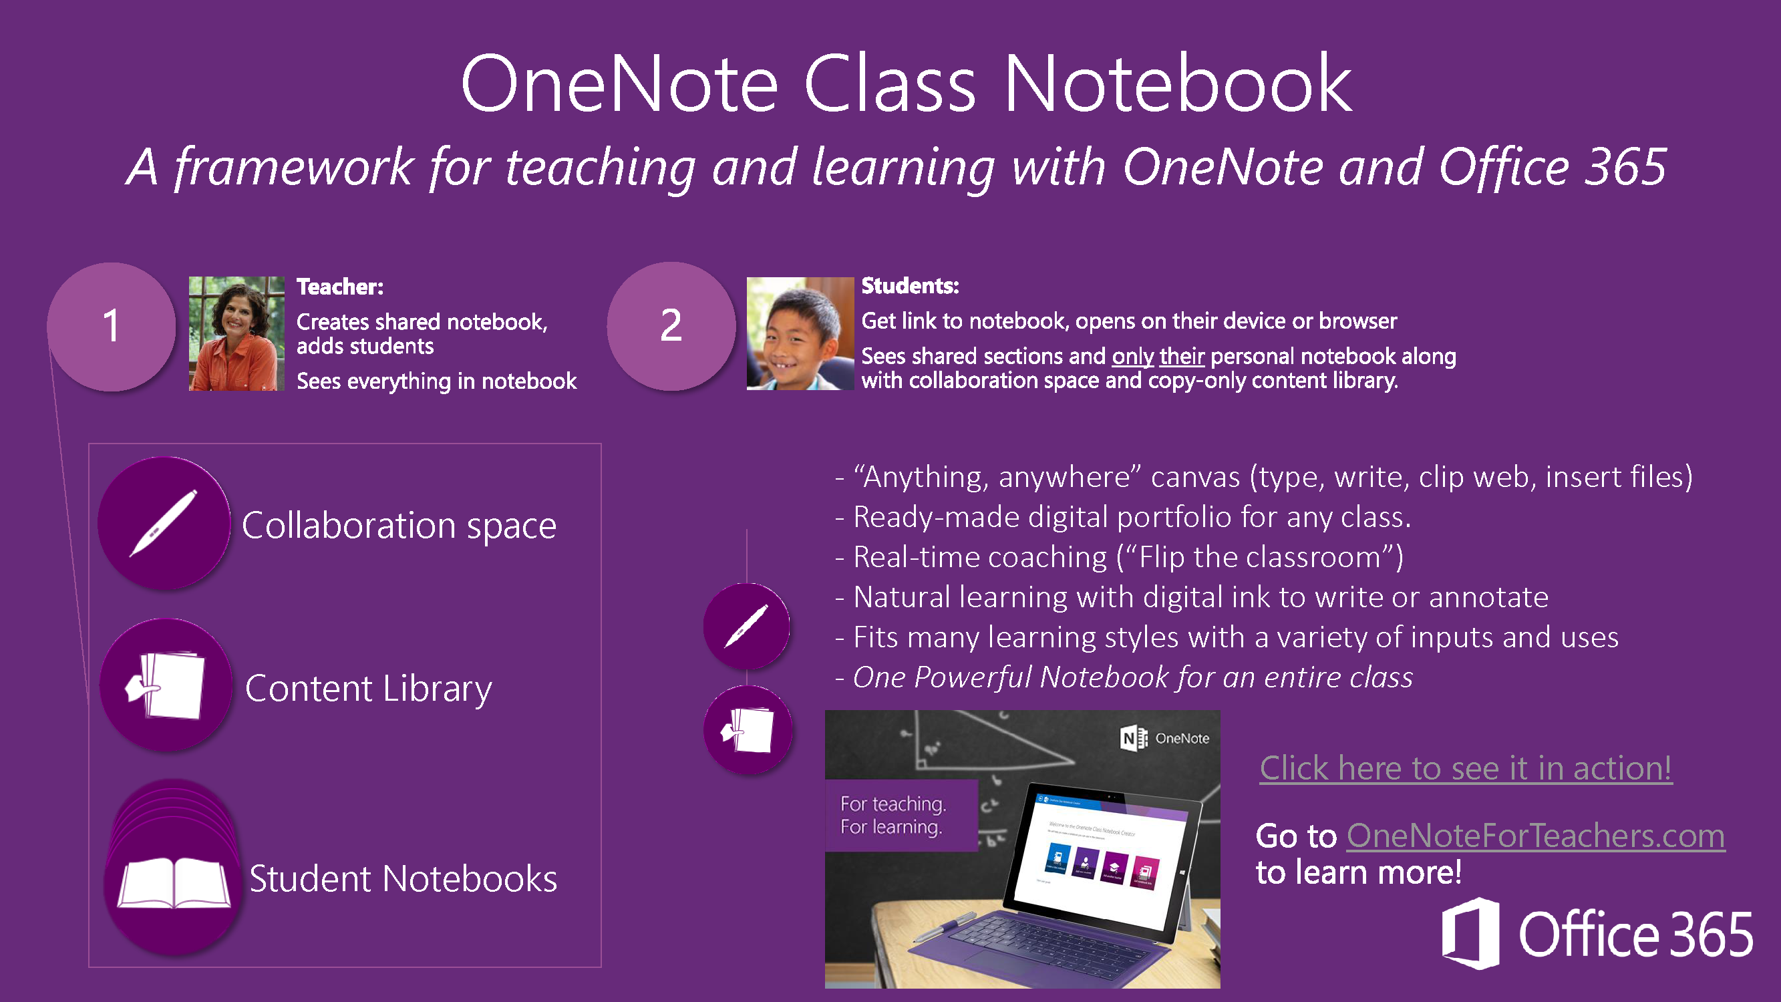
Notes:
Can be integrated with Canvas LMS,
Emphasize notes, digital ink
Lecture presentation notes
Training site from Microsoft available.

Slide 19
OneNote to Canvas

Slide 20

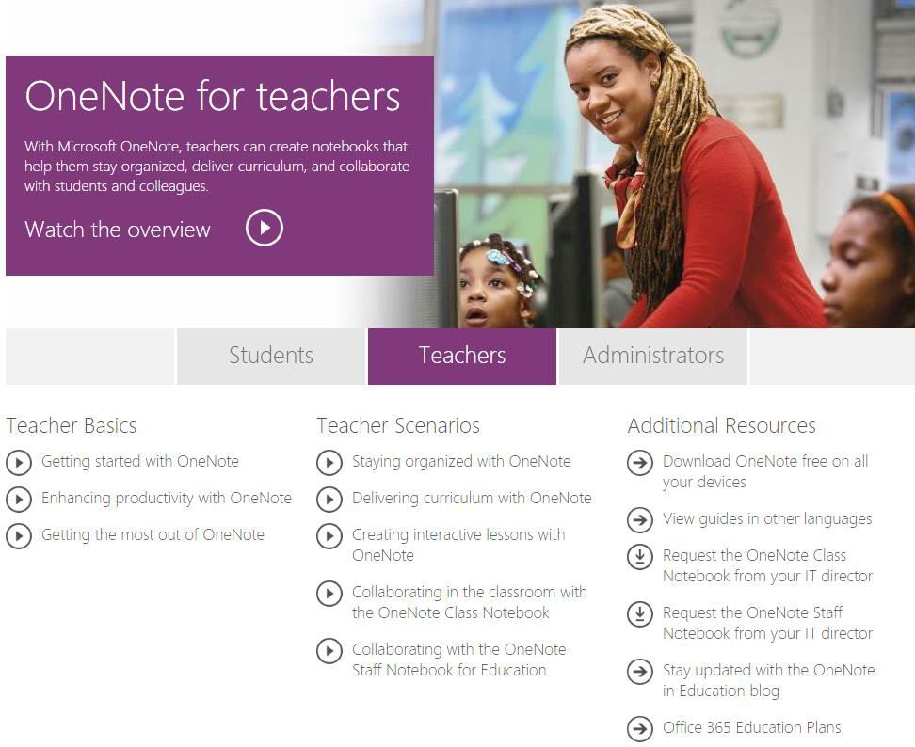
FREE Bite-sized interactive
Teacher Training for OneNote in Education
Scenarios based on Teacher feedback
Easy to follow guides with clicks, only 5-7 minutes
Embeddable Links for blogs, websites
Built-in Viral Sharing
http://www.OneNoteInEducation.com

Slide 21

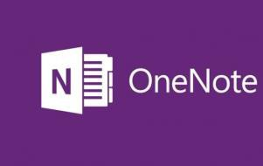













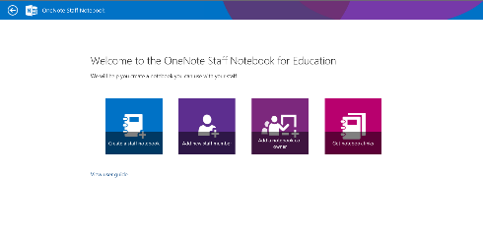








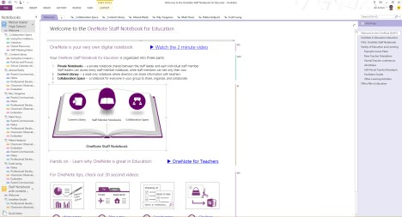




School Leader/Administrator:
Creates staff notebook, adds staff members
Sees everything in notebook
Staff Member/Instructor:
Get link to notebook, opens on their device or browser
Sees shared sections and only their personal notebook along with collaboration space and copy-only content library.
1
2
School administrators can quickly set up a shared, permissioned OneNote notebook with an easy Office 365 app. Uses include:
Collaboration: Staff meeting notes / Staff initiatives / Shared Lesson Plan Development / Data Chats / Scope and Sequence Across Content and Grades
/ Fundraisers / Book Studies / PLC’s
Collaboration space
Content Library
Content Library: Policies and procedures / Various school planning and calendar activities
My
Staff Member Private Notebooks
Staff Member Notebooks (Private): Professional development / Classroom observations /Lesson Plans / Parent communication / Evaluations / Classroom data progress
Notebook

Slide 22

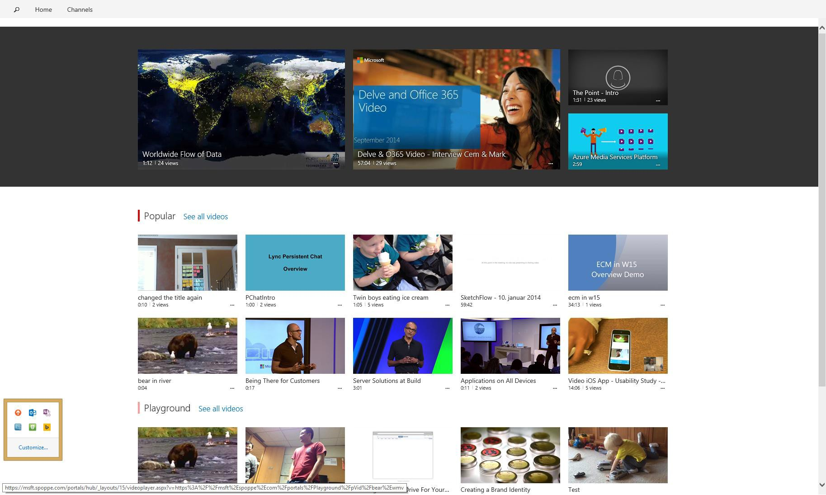

Spotlight videos allow for home and channel page curation.
Popular channel is driven by views, future will be powered by the Office Graph.
You can also pin up to three channels to highlight on the home page.

Slide 23


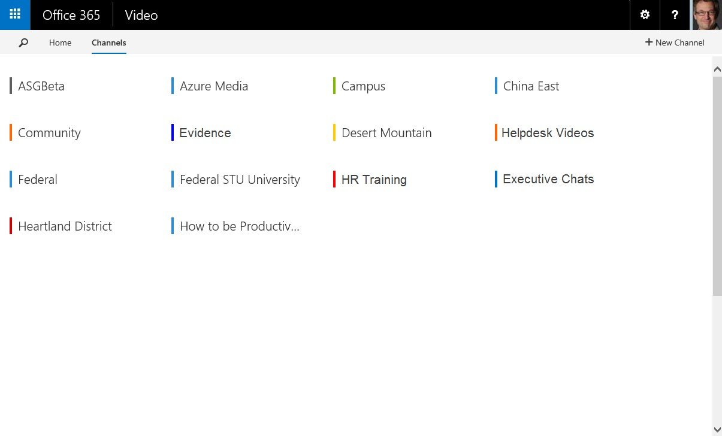

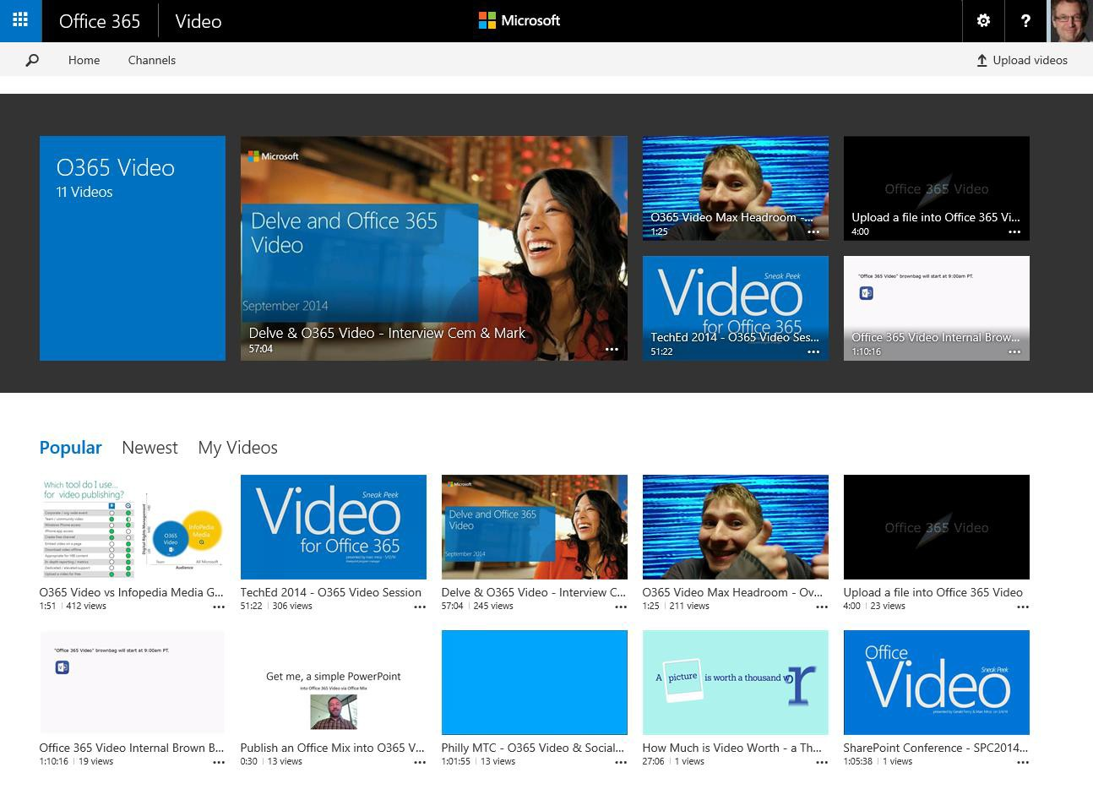
You can easily create new channels for all sorts of scenarios like Helpdesk, Class Presentations, and School Events.
All channels appear when you click into Channels at the top of the Office 365 Video portal.
On a channel page, all of videos appear below the Spotlight section with several available views.

Slide 24


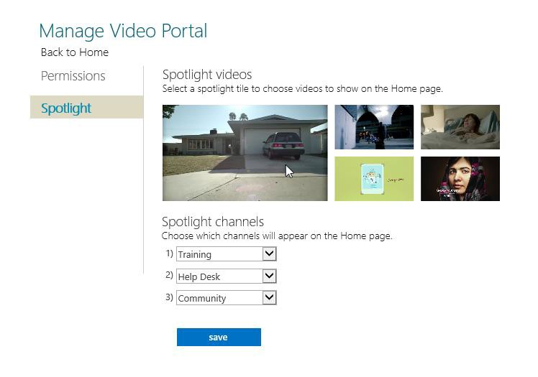

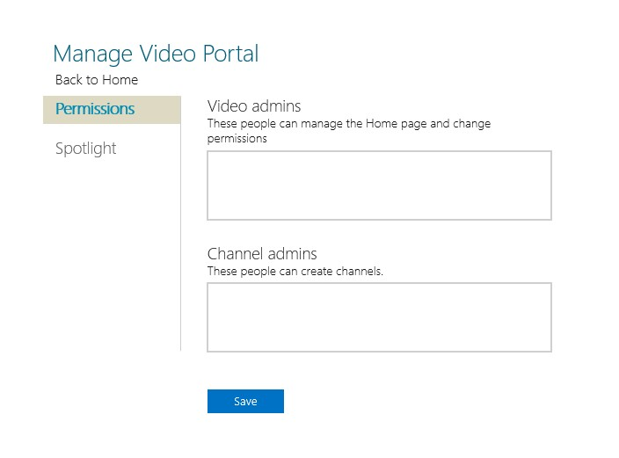
Manage permissions uniquely for the home page and each channel to meet your required governance plan
Choose which videos to include in the Spotlight section of the home page and each channel page.
You can choose up to three channels to be highlighted on the home page.
Notes:
Locally administer access

Slide 25


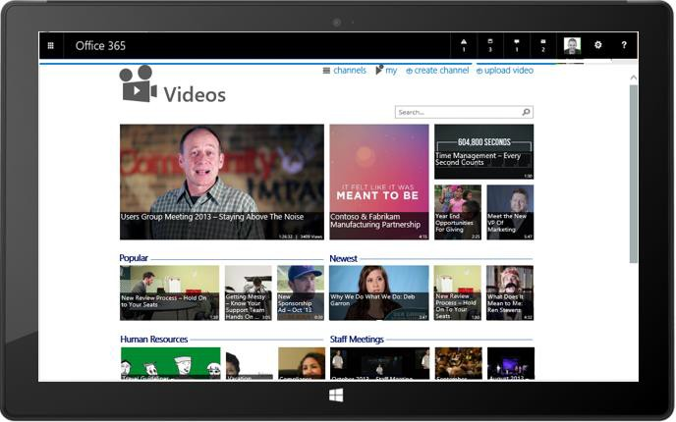
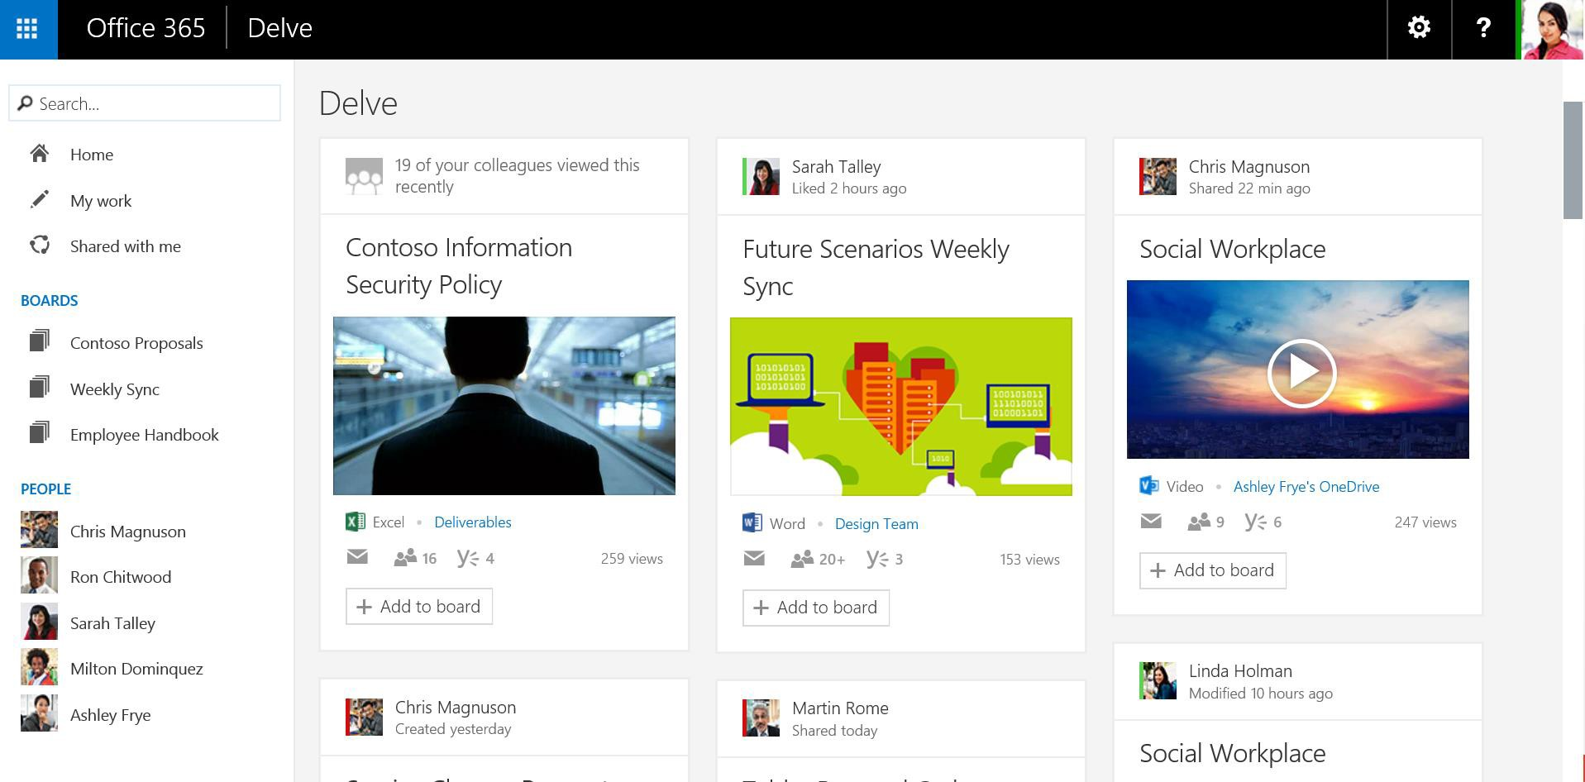
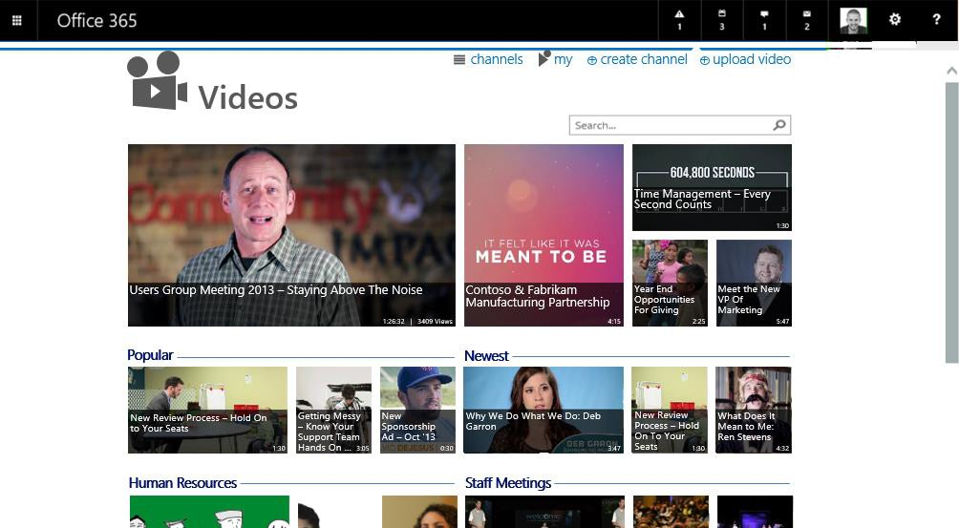
Quickly get to the information you need with intuitive views
Discover new information tailored to you
Easy access to the people you work closely with
Notes:
Analytics – Shows you documents/content you may have interest
Only shows you content you can access

Slide 26
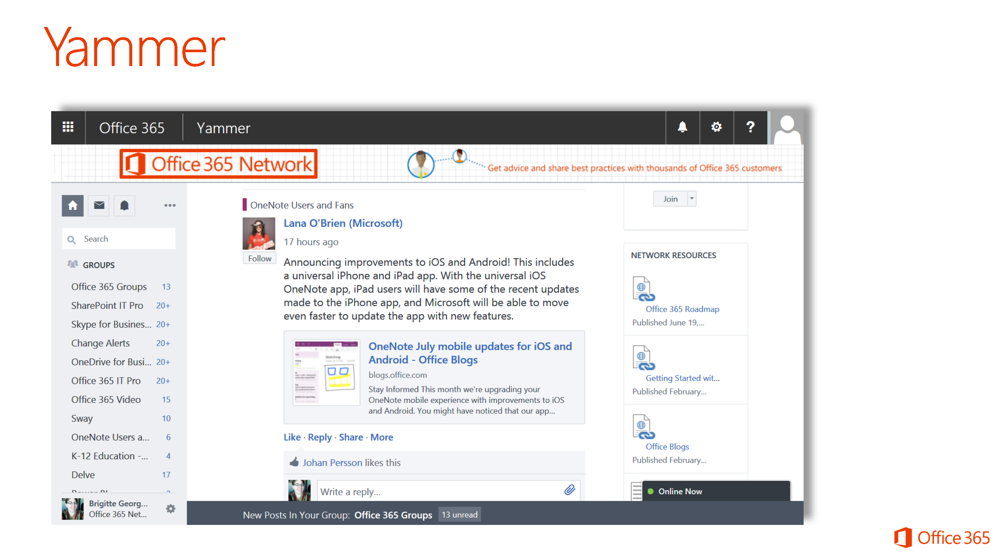

Slide 27
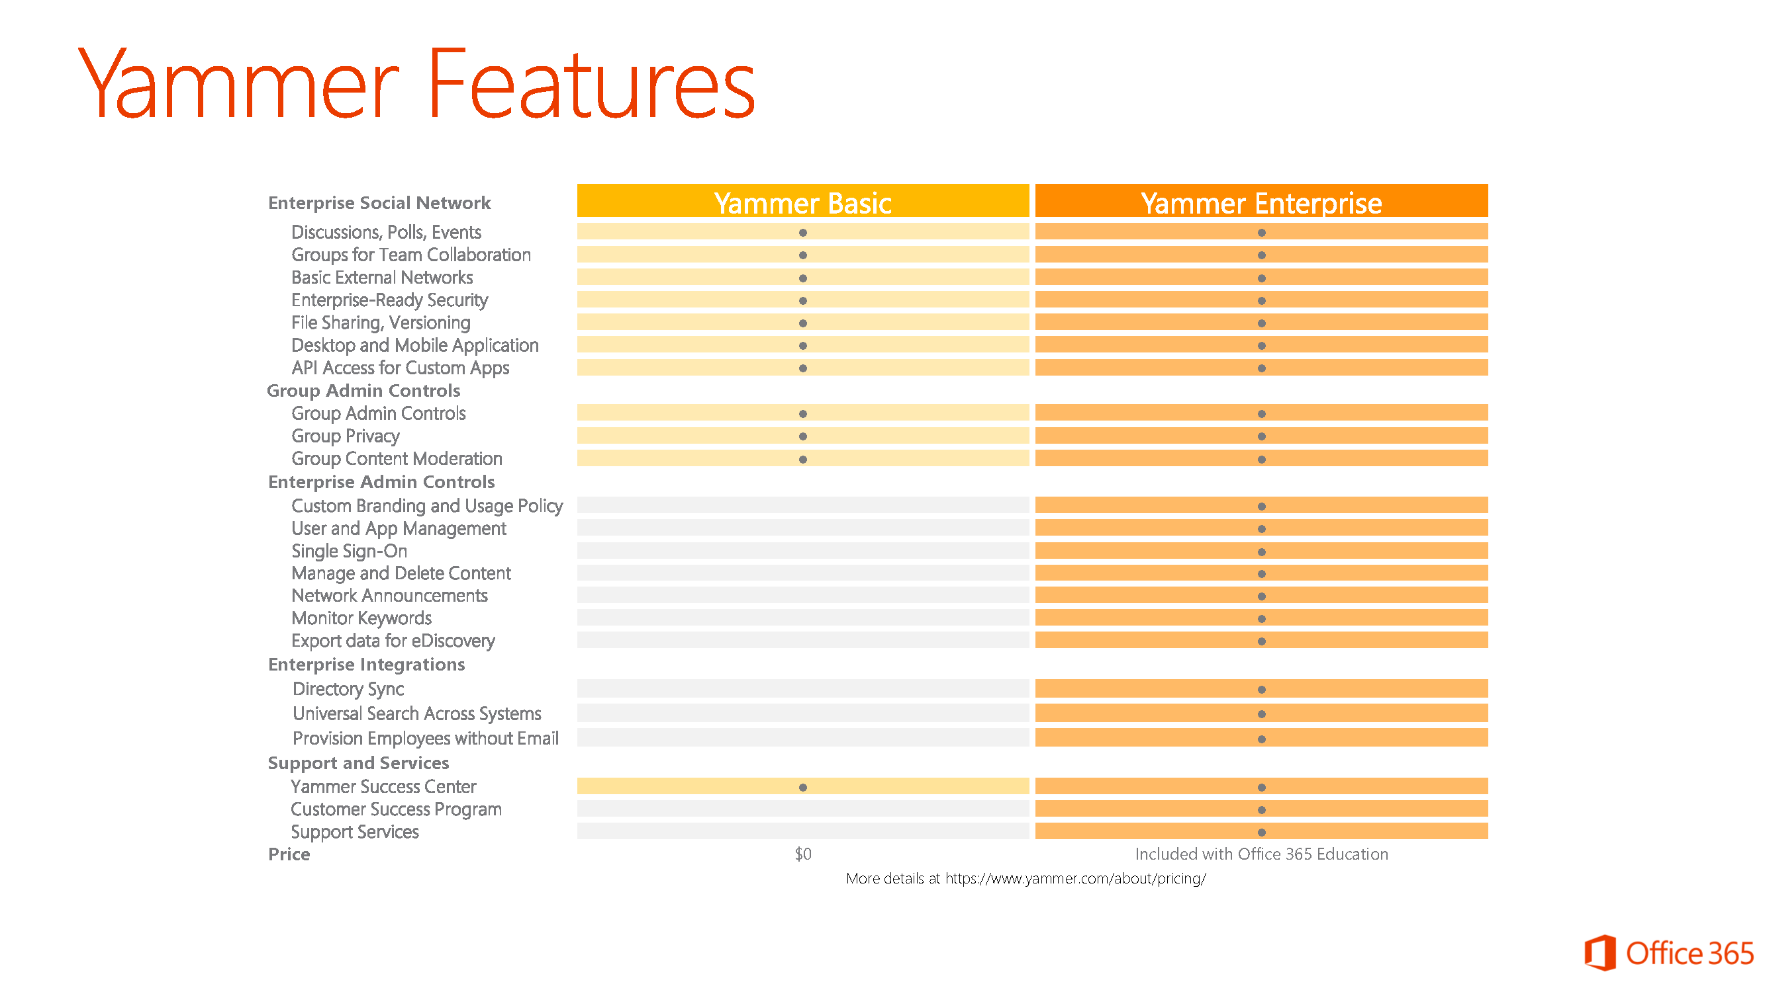

Slide 28

versus

Slide 29
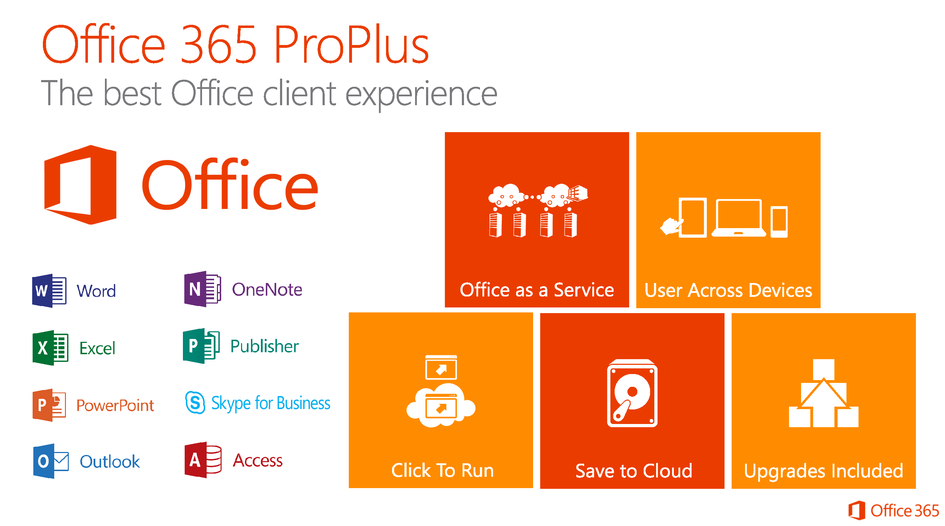
Notes:
Full version of Office

Slide 30
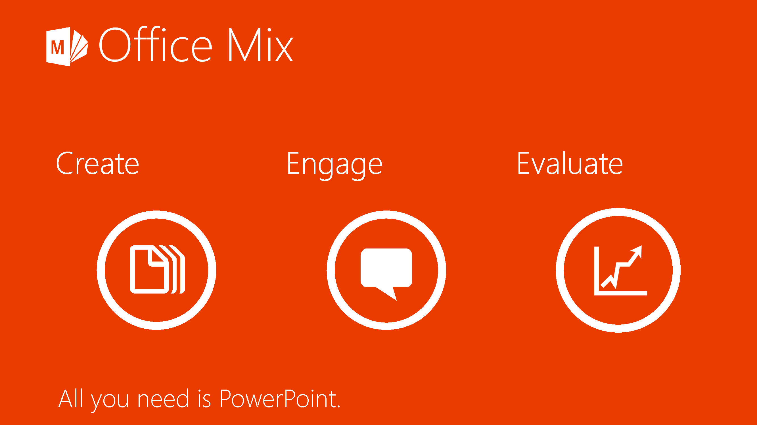

Slide 31
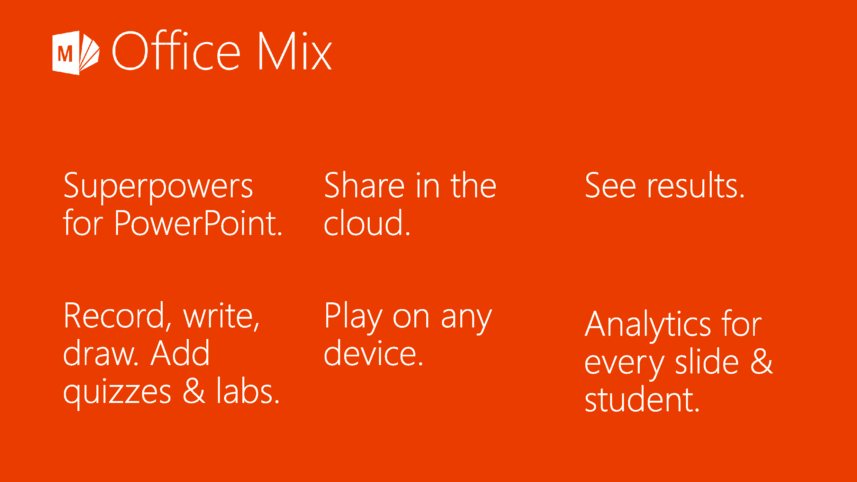
Notes:
Audio and video narration
Real-time digital inking
Screen recordings that show actions you take on your computer
Quizzes and polls
Simulations, videos, and live web pages

Slide 32

High-fidelity animations
Audio-video narration
Free-form inking
Quizzes and polls
Interactive simulations
Hyperlinks
Embedded web pages
Embedded and linked videos
Built-in screen capture

Slide 33
Office Mix Video

Slide 34
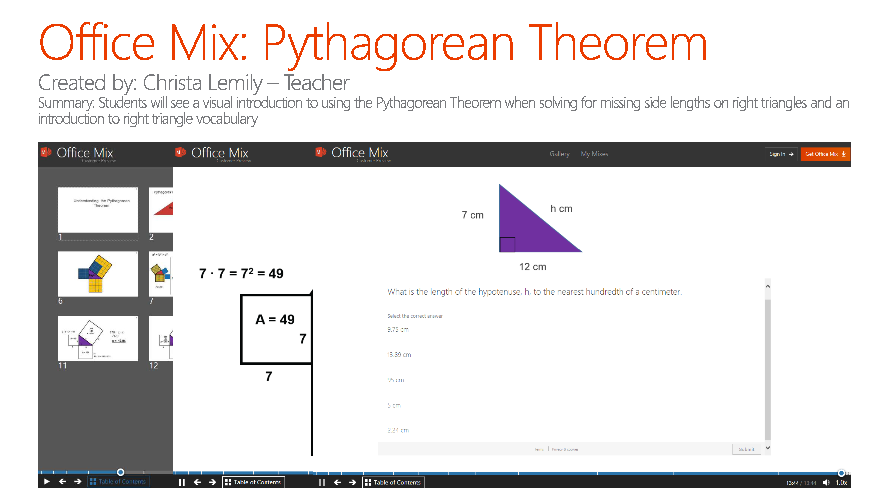

Slide 35
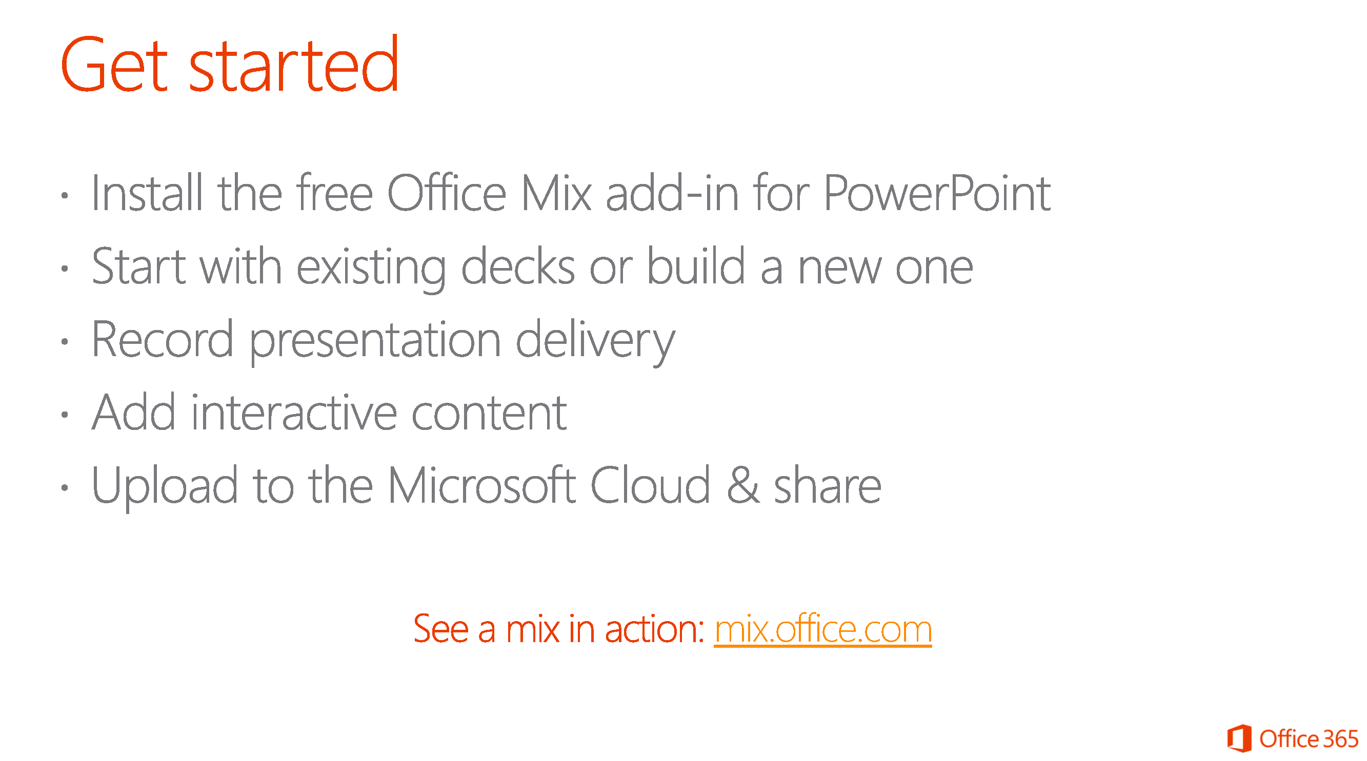
Notes:
Suggestion – Wait until we have the full District implementation of Office 365.

Slide 36
&

Slide 37

Service Descriptions Office 365 Admin Help OneNote Class Notebook OneNote Staff Notebook OneNote for Teachers Office 365 Video
Office 365 Groups
Office Mix
Office Delve
Office 365 Trust Center Office 365 Roadmap
Microsoft Education

Slide 38

Office 365: Overall name for Microsoft’s Software as a Service offerings. Includes Exchange Online, SharePoint Online, OneDrive for Business, etc. Not to be confused with Azure!
Tenant: Your suite in the overall Office 365 condominium.
Domain: One of your rooms in your suite.
Plan: Your bundle of individual services.
Online: Hosted by Microsoft in our data centers across the United States, safely and securely.
On-Premises: Hosted by you, the Customer, on your servers locally.

